Slide 2
Project Planning using Microsoft Project
Syed Ali Raza - PMP, MCTS, PE, OCP

Slide 3
2013
Work Management Solutions for Individuals, Teams and the Enterprise

Slide 4
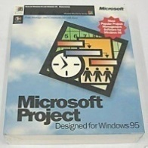
Microsoft Project Evolution From desktop scheduling to project and portfolio management
2016
Financial
Management
Resource
Management
1987
Portfolio
Management
Reporting
Scheduling
Simple reporting
Task management
Print
Resource tracking
Program
Management
Project
Collaboration
Notes:
The world of Project management has changed a lot since we released Microsoft Project
As customer requirements and technology has evolved, in-turn Project has grown from essentially a desktop scheduling and resource management tool to a complete set of PC and web-based project and portfolio management solutions.
The Microsoft Project family of users is on the verge of 20 million, with a diverse customer base—from boutique firms to multinational corporations. For example, roughly 80% of Project Server customers are organizations with more than 50,000 employees.
In 2007, 2008 and 2009 the Microsoft Enterprise Project Management (or EPM) Solution was listed as a leader in Gartner’s IT Project and Portfolio Management Magic Quadrant and is recognized by IDC as a leading PLM (or Product Lifecycle Management) / NPD (New Product Development) solution.
We now have more than 1,000 EPM partners in our network, with more than 600 Project-compatible solutions built on the 2007 solution. Project’s appeal is rapidly spilling beyond IT departments into the wider enterprise as a way to initiate and execute projects that align with the organization’s strategic priorities—including those for governance and innovation management.

Slide 5
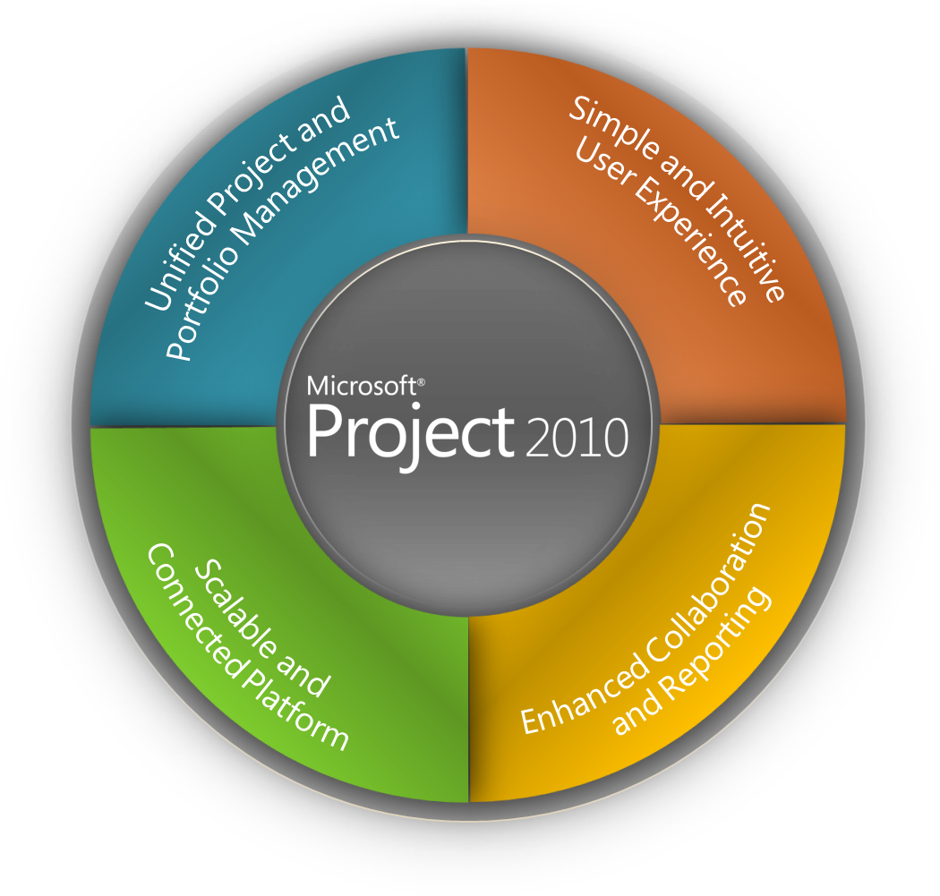
Project Work Management Solutions for Individuals, Teams and the Enterprise
Notes:
Project builds on the foundation of Project 2007 to provide work management solutions for individuals, teams and the enterprise.
The architectural improvements in Microsoft Office Project 2007 provided a strong foundation to develop innovative new capabilities that will further differentiate Project from other PPM vendors.
Microsoft Project includes continued investments in Project Standard, Professional, and the Enterprise Project Management (EPM) Solution to provide executives, portfolio analysts, managers, and team members with productivity tools to effectively manage all work (both non-project and project) throughout its lifecycle, and ensure alignment with the organization’s business strategy.
Project is arguably the biggest release for Project in over a decade.
We have grouped the new enhancements into four investment areas:
Unified Project and Portfolio Management
Simple and Intuitive User Experience
Enhanced Collaboration and Reporting
Scalable and Connected Platform
The remaining slides in this deck provide a brief overview of some of the main features / capabilities included in Project

Slide 6
Enterprise Microsoft Project Server
A lot of vendors are out there on the so called PPM market today. However, Microsoft® has with their latest release of Microsoft® Enterprise Project Management (Microsoft® Project) solution achieved to be evaluated as leaders by multiple research institutes such as Gartner

Slide 7
Microsoft Project Customer Success

Slide 8
Microsoft Project Customer Success

Slide 9
Microsoft Project Customer Success
Over 20 million people choose Microsoft Project and 10,000 organizations utilize Microsoft Project Server
Volvo IT
We use Project Server to gain more control over which projects we are starting and stopping, and when. This means we contract out fewer assignments based on sudden demand fluctuations.
Stéphane Perrin Director, Product Planning and Project Management Solutions Volvo IT

Slide 10
Microsoft Project Customer Success
Schlumberger
Our enterprise project management solution has improved processes at Schlumberger, reducing costs, accelerating schedules, and delivering even better service to clients.
Vishy Narayanamurthy IT Project Manager for Avance, Schlumberger

Slide 11
Microsoft Project Customer Success
Intel
Project Server is a very flexible product. We can configure it to meet the different scheduling requirements of our internal customers.
Liesl Andrico System Analyst, Enterprise Scheduling Team Intel

Slide 12
Microsoft Project Customer Success
Ministry - British Columbia
We chose Project Server because we can customize the solution to meet our specific requirements. We also selected the software because so many people within the organization are used to working with Microsoft Office applications, and would therefore be familiar with its user interface.
Tom Dendes Senior Development Analyst Ministry of Aboriginal Relations and Reconciliation, Province of British Columbia

Slide 13
Project Management
Exercise:
How Microsoft Project can help us

Slide 14
Project Management
With a good project management system in place, you should be able to answer such questions as:
What tasks must be performed, and in what order, to produce the deliverable of the project?
When should each task be performed, and what is the final deadline?
Who will complete these tasks?
How much will it cost?
What if some tasks are not completed as scheduled?
What’s the best way to communicate project details to those who have an interest in the project?

Slide 15
A Guided Tour of Project
Use the Backstage view to open and save Project files.
Work with commands on different tabs of the ribbon interface, the major visual change introduced in Project .
Use different views to see Project information presented in different ways.

Slide 16
A Guided Tour of Project
MS Project is available in two different editions:
Project Standard is the entry-level desktop application with which you can create and modify project plans.
Project Professional includes all the functionality of Project Standard plus a few additional features you can use to create and modify project plans. In addition, Project Professional can connect to Microsoft Project Server, the Enterprise Project Management (EPM) solution from Microsoft.

Slide 17
A Guided Tour of Project
Introducing Project
You can start Project from the Start menu or by opening a Project file. In this exercise, you’ll start Project without opening a project plan and then examine the major parts of the interface.
1. On the Windows taskbar, click Start.
The Start menu appears.
2. On the Start menu, point to All Programs, click Microsoft Office, and then click Microsoft Project .

Slide 18
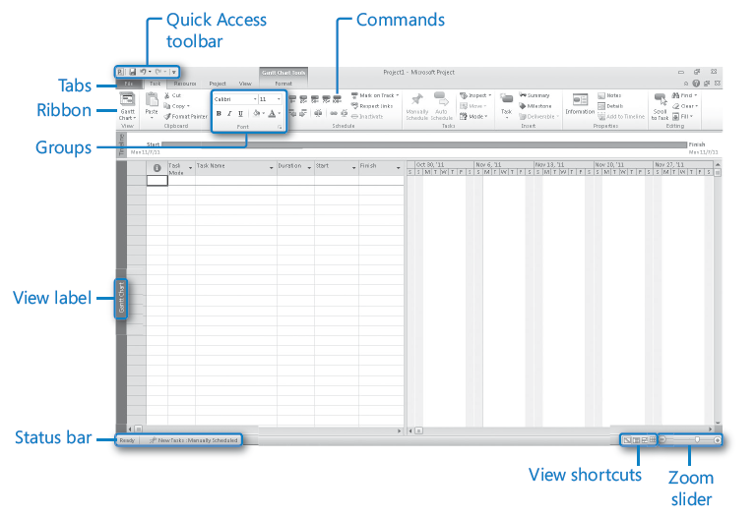
A Guided Tour of Project

Slide 19
A Guided Tour of Project
The Quick Access toolbar is a customizable area of the interface where you can add your favorite or frequently used commands.
Tabs and the active ribbon replace the pull-down menus and toolbars that you may be familiar with. Tabs group high-level focus areas of Project together.
One tab is always selected, and its ribbon is visible. The ribbon contains the commands that you use to control Project.
Groups are collections of related commands. Each ribbon is divided into multiple groups.
Commands are the specific features you use to control Project. Each ribbon contains several commands. Some commands, like Cut on the Task tab, perform an immediate action. Other commands, like Change Working Time on the Project tab, display a dialog box or prompt you to take further action in some other way. You can see a description of most commands by pointing the mouse pointer at the command.

Slide 20
A Guided Tour of Project
The Status bar displays some important details like the scheduling mode of new tasks (manual or automatic), and if a filter has been applied to the active view.
Shortcut menus and mini-toolbars are accessible via right-clicking most items you see in a view.

Slide 21
A Guided Tour of Project
The Backstage: Managing Files and Setting Options
Save, Save As, Open, and Close are standard file management commands.
Info also shows you project information like start and finish date, statistics, and advanced properties.
Recent displays the last several Project files that you have opened.
New displays options for creating a new project plan, either from scratch or based on a template.
Print includes options for printing a project plan, as well as the print preview.
Save & Send
Help gives you options for viewing the online Help installed with Project, as well as various Web resources. Help also includes the “About Microsoft Project” details, including your edition of Project: Standard or Professional.
Options displays the Project Options dialog box (similar to the Options command on the Tools menu in previous versions of Project). This dialog box itself contains several tabs through which you can adjust a wide range of behaviors in Project, such as the default view you want to see when Project starts.
Exit closes Project.

Slide 22
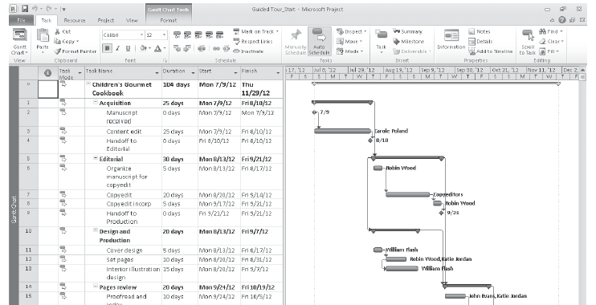
A Guided Tour of Project
On the File tab, click Open.
The Open dialog box appears.
Open Guided Tour_Start from the Chapter01 practice file folder.
The practice file opens.

Slide 23
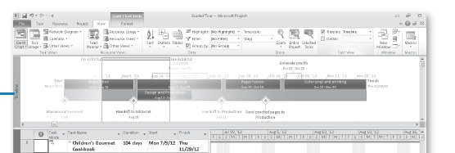
A Guided Tour of Project
The Ribbon and Tabs:
The Tasks and Resources tabs relate to the data you frequently work with in Project.
The Project tab contains commands that usually apply to the entire project plan.
The View tab helps you control what you see in the Project window and how that information appears.
The Format tab
Timeline view

Slide 24
A Guided Tour of Project
Templates: Avoid Reinventing the Wheel
Instead of creating a project plan from scratch, you may be able to use a template that includes much of the initial information you need, like task names and relationships.
Templates from the Office Online Web site, www.office.com. Microsoft makes a large number of Project templates available for free download via the Web.
Templates within your organization. You may be in an organization that has a central library of templates. Often such templates contain detailed task definitions, resource assignments, and other details that are unique to the organization.
To see available templates, click the File tab and then click New.

Slide 25
A Guided Tour of Project
Templates: Avoid Reinventing the Wheel
You can also create templates from your project plans for later use or to share. One common concern with sharing project plans is they may contain sensitive information like resource pay rates.
You can save a project plan as a template and clear such information, as well as schedule progress.
To do this, on the File tab, click Save As. In the “Save as type” box, click Project Template, enter the template file name that you want, and then click Save. When the Save As Template dialog box appears, select the types of information, such as pay rates, that you want removed from the template. The original project plan is not affected.

Slide 26
A Guided Tour of Project
Key Points
The Backstage view is the central location for managing files and customizing Project.
The Fluent user interface, commonly called the ribbon interface, is a major visual change introduced in Project . Commands are grouped on tabs for quick access.
The main working space in Project is a view. One view (or sometimes two views) are typically displayed at a time. The Gantt with Timeline view is the default; the Gantt Chart is probably the best-known view in Project, and the Gantt chart is the best-known concept in project management as a whole.

Slide 27
A Guided Tour of Project
Exercise:
Open Chapter and check all available options

Slide 28
Creating a Task List
Start Microsoft Project Standard or Professional and save a new project plan.
Enter task names.
Estimate and record how long each task should last.
Create a milestone to track an important event.
Organize tasks into phases.
Create task relationships by linking tasks.
Switch task scheduling from manual to automatic.
Set nonworking days for the project plan.
Check the project plan’s overall duration.
Record task details in notes and insert a hyperlink to content on the Web.

Slide 29
Creating a Task List
Tasks are the most basic building blocks of any project—tasks represent the work to be done to accomplish the goals of the project.
Tasks describe project work in terms of sequence, duration, and resource requirements.
In Project, there are several different kinds of tasks.
These include summary tasks, subtasks, and milestones.
More broadly, what are called tasks in Project are sometimes also called activities or work packages.

Slide 30
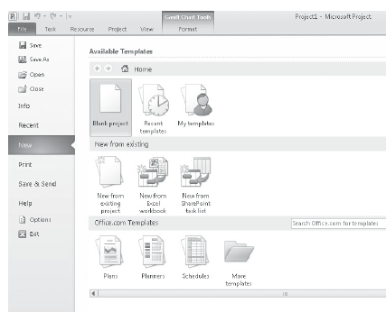
Creating a Task List
Creating a New Project Plan
Tracks tasks, resources, time frames, and possibly their associated costs.
Exercise:
Click the File tab.
Project displays the Backstage view.
Click the New tab.
Under Available Templates,
make sure that Blank project is
selected, and
then click the Create button

Slide 31
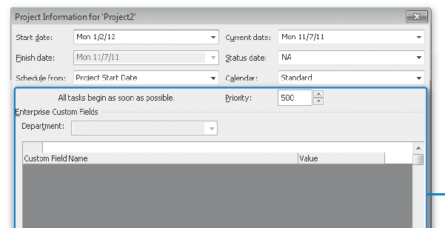
Creating a Task List
Creating a New Project Plan
On the Project tab, in the Properties group, click Project Information.
The Project Information dialog box appears.
Important If you are using Project Professional rather than Project Standard, the Project Information and some other dialog boxes contain additional options relating to Project Server.
In the Start Date box, type Current Date, or click the down arrow to display the calendar and
select Current Date.
Click OK
On the File tab, click Save.
In he File name box, type
Simple Tasks.

Slide 32
Creating a Task List
Entering Task Names
Tasks represent the work to be done to accomplish the goals of the project.
Task names should be recognizable and make sense to the people who will perform the tasks and to other stakeholders who will see the task names.

Slide 33
Creating a Task List
Guidelines for creating good task names:
Use short verb phrases that describe the work to be done, such as “Edit manuscript.”
If tasks will be organized into phases, don’t repeat details from the summary task name in the subtask name unless it adds clarity.
If tasks will have resources assigned to them, don’t include resource names in the task names.

Slide 34
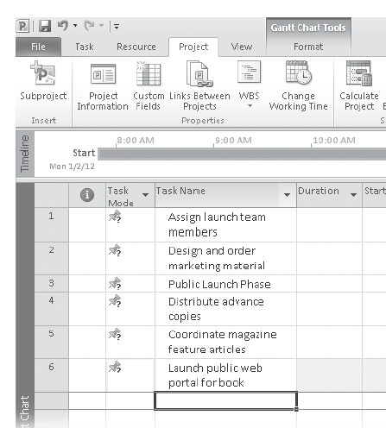
Creating a Task List
Exercise:
Enter some initial tasks required for the new book launch events.
Click the cell directly below the Task Name column heading.
Type Assign launch team members, and then press the Enter key.
Type Design and order marketing material
Type Public Launch Phase
Type Distribute advance copies
Type Coordinate magazine feature articles
Type Launch public web portal for book

Slide 35
Creating a Task List
Exercise:

Slide 36
Creating a Task List
Project Management Focus: Defining the Right Tasks for the Deliverable
Every project has an ultimate goal or intent: the reason that the project was started.
This is called the project deliverable. This deliverable might be a tangible product, such as a new book, or a service or event, such as a product launch party.
Defining the right tasks to create the deliverable is an essential skill for a project manager.
When developing your task lists, you might find it helpful to distinguish product scope from project scope.
Product scope describes the quality, features, and functions of the deliverable of the project.
For Book Project - the product scope might include its number of pages and illustrations.
Project scope, on the other hand, describes the work required to deliver such a product or service. The Project Scope includes detailed tasks relating to generating publicity and advance reviews for the book.
Notes:
Work on that slide

Slide 37
Creating a Task List
Durations UNITS:
Notes:
Give examples and discuss with class

Slide 38
Creating a Task List
Entering Durations
Automatically scheduled tasks: always have a duration (one day by default).
Manually scheduled tasks, however, do not initially have any duration and you can also enter text values.

Slide 39
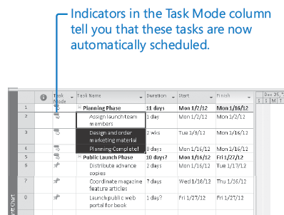
Creating a Task List
Switching Task Scheduling from Manual to Automatic:
In the Task Mode column.
On the Task tab, in the Tasks group, click Auto Schedule.
Project switches tasks to
be automatically scheduled.

Slide 40
Creating a Task List
How Do You Come Up with Accurate Task Durations?
Historical information from previous, similar projects
Estimates from the people who will complete the tasks
The expert judgment of people who have managed similar projects
The standards of professional or industrial organizations that carry out projects similar to yours
For complex projects, you probably would combine these and other strategies to estimate task durations.
Inaccurate task duration estimates are a major source of risk in any project, making good estimates is well worth the effort expended.

Slide 41
Creating a Task List
How Do You Come Up with Accurate Task Durations?
One general rule of thumb to consider is called the 8/80 rule.
This rule suggests that task durations between 8 hours (or one day) and 80 hours (10 working days, or two weeks) are generally sized about right.
Tasks shorter than one day might be too granular, and tasks longer than two weeks might be too long to manage properly.
There are many legitimate reasons to break this rule, but for most tasks in your projects, it’s worth considering.

Slide 42
Creating a Task List
Entering a Milestone
Milestones are significant events that are either reached within the project (such as completion of a phase of work)
Can be imposed upon the project (such as a deadline by which to apply for funding).
Milestone itself doesn’t normally include any work, milestones are represented as tasks with zero duration.

Slide 43
Creating a Task List
Entering a Milestone:
Exercise:
Click the name of task, Public Launch Phase.
On the Task tab, in the Insert group, click Milestone.
Project inserts a row for a new task and renumbers the subsequent tasks. Project names the new task “<New Milestone>” and gives it a zero-day duration. As with the other new tasks, the milestone is initially scheduled at the project start date of January 2.
Type Planning complete! and then press Enter.
The milestone task is added to your plan.

Slide 44
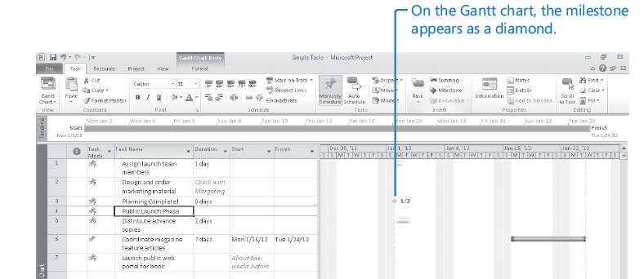
Creating a Task List
Entering a Milestone

Slide 45
Creating a Task List
Project Management Focus: Top-Down and Bottom-Up Planning
Top-down planning identifies major phases or components of the project before filling in the tasks required to complete those phases. Complex projects can have several layers of phases. This approach works from general to specific.
Bottom-up planning identifies as many of the bottom-level detailed tasks as possible before organizing them into logical groups called phases or summary tasks.

Slide 46
Creating a Task List
Organizing Tasks into Phases
It is helpful to organize groups of closely related tasks into phases.
For example, it is common to divide book publishing projects into Editorial, Design, and Production phases.
You create phases by indenting and outdenting tasks. In Project, phases are represented by summary tasks, and the tasks indented below the summary task are called subtasks.

Slide 47
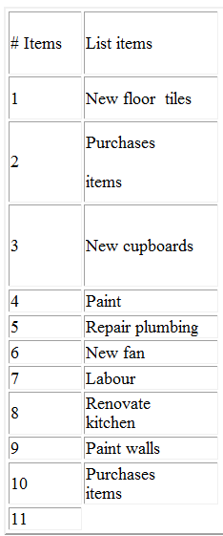
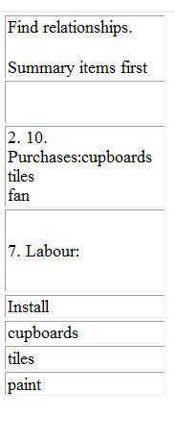
Exercise: Renovating the kitchen (WBS / Project plan)
Use Microsoft Project for tasks
Identify the list items
Identify Summary level and Summary Task
Project Start Day: 11 Apr-16
Save Project : Name – Renovating Kitchen
17

Slide 48
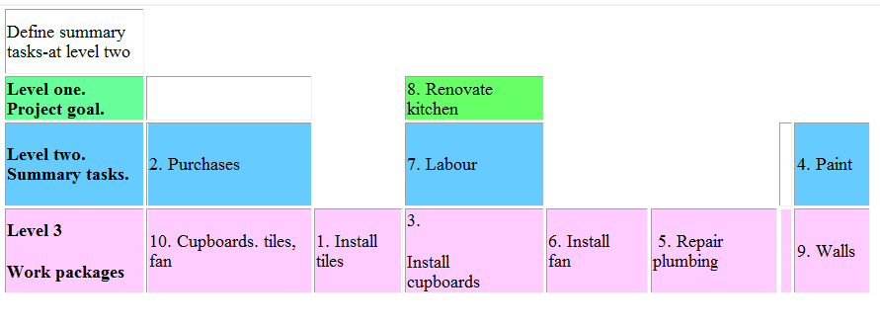
WBS - Renovating the kitchen.
18

Slide 49
Creating a Task List
Linking Tasks
The task of writing a chapter of a book must be completed before the task of editing the chapter can occur. These two tasks have a finish-to-start relationship (also called a link or a dependency), which has two aspects:
The second task must occur after the first task; this is a sequence.
The second task can occur only if the first task is completed; this is a dependency.

Slide 50
Creating a Task List
Linking Tasks:
You can adjust the schedule relationship between Predecessor and Successor tasks with lead and lag time.
For example, you can set a two-day lag between the end of a predecessor task and the start of its successor task.
Notes:
examples

Slide 51
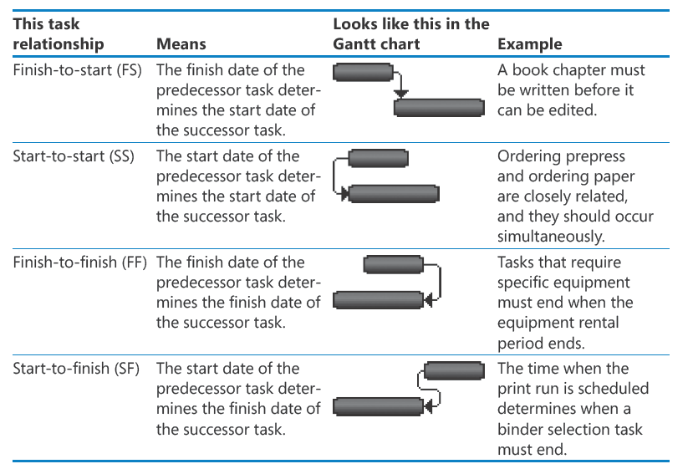
Creating a Task List
Linking Tasks

Slide 52
Creating a Task List
Linking Tasks:
On the Task tab, in the Schedule group, click Link Tasks.
On the Task tab, in the Properties group, click Information.
The Task Information dialog box appears.
Click the Predecessors tab.
Notes:
Add visual for better understanding

Slide 53
Creating a Task List
Setting Nonworking Days:
The project calendar defines the general working and nonworking time for tasks. Project includes multiple calendars, called base calendars, any one of which serves as the project calendar for a project plan. You select the project calendar in the Project Information dialog box.
Think of the project calendar as your organization’s normal working hours. For example, this might be Monday through Fridays, 8 A.M. through 5 P.M., with a one-hour lunch break each day. Your organization or specific resources might have exceptions to this normal working time, such as holidays or vacation days.

Slide 54
Creating a Task List
Setting Nonworking Days:
You want to indicate that January 19, will be a nonworking day for your organization.
On the Project tab, in the Properties group, click Change Working Time.
The Change Working Time dialog box appears.
Select Standard base calendar
Mark morale event on January 19; no work should be scheduled that day. You will record this as a calendar exception.
In the Name field on the Exceptions tab in the lower portion of the dialog box, type Staff at morale event, and then click in the Start field.

Slide 55
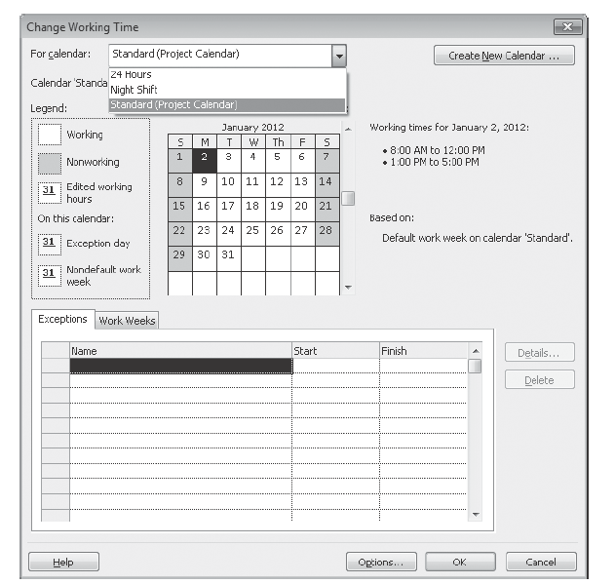
Creating a Task List
Setting Nonworking Days:

Slide 56
Creating a Task List
Setting Nonworking Days:
Exercise, you’ll create a working time exception in the project calendar.
You want to indicate that January 19, will be a nonworking day for your organization.
On the Project tab, in the Properties group, click Change Working Time. The Change Working Time dialog box appears.
Select Standard base calendar
In the Name field on the Exceptions tab in the lower portion of the dialog box, type Staff at morale event, and then click in the Start field.
In the Start field, type 1/19/14, and then press Enter.
Click OK to close the Change Working Time dialog box.

Slide 57
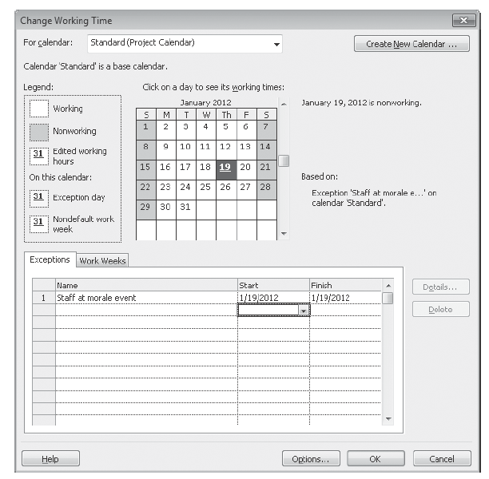
Creating a Task List
Setting Nonworking Days:

Slide 58
Creating a Task List
If needed, you can schedule tasks to occur during working and nonworking time. To do this, assign an elapsed duration to a task.
You enter elapsed duration by preceding the duration abbreviation with an e.
For example, type 3ed to indicate three elapsed days.
You might use an elapsed duration for a task that goes on around the clock rather than just during normal working hours.

Slide 59
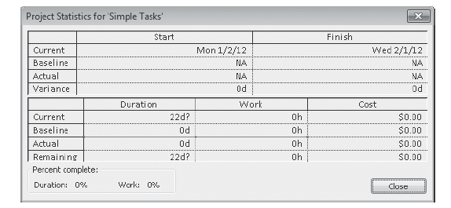
Creating a Task List
Checking the Plan’s Duration
An easy way to view the project’s scheduled start and finish dates is via the Timeline view and the Project Information dialog box.
On the Project tab, in the Properties group, click Project Information.
Click Statistics.

Slide 60
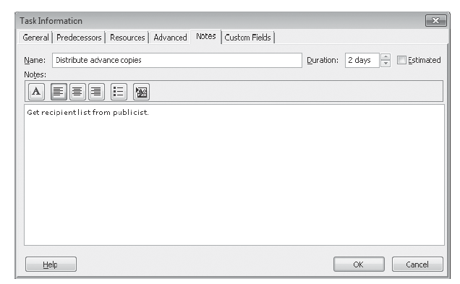
Creating a Task List
Documenting Tasks and the Project Plan
You can record additional information about a task in a note.
Select the name of task
On the Task tab, in the Properties group, click Task Notes.

Slide 61
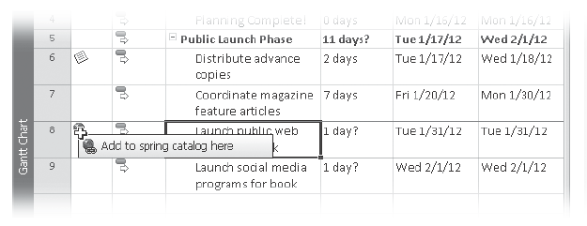
Creating a Task List
Documenting Tasks and the Project Plan
Hyperlink can be inserted.
Right-click the name of task, and then click Hyperlink on the shortcut menu.
The Insert Hyperlink dialog box appears.

Slide 62
Creating a Task List
Documenting Tasks and the Project Plan
Additional information can be recorded about the project plan. Like other Microsoft Office programs, Project keeps track of several file properties.
Click the File tab - Project Information - Advanced Properties.
In the Subject box, type New book launch schedule.
In the Author box, type your name.
In the Company box, type Lucerne Publishing.

Slide 63
Creating a Task List
Key Points
Essential aspects of tasks in a project plan include their duration and order of occurrence.
A common task relationship is a finish-to-start relationship, in which the completion of one task controls the start of another task.
In Project, phases of a schedule are represented as summary tasks.
Tasks can be manually or automatically scheduled.
You use calendars in Project to control when work can be scheduled to occur.
You can document additional details using task notes and create hyperlinks to the Web.

Slide 64
Setting Up Resources
Set up basic resource information for the people who work on projects.
Adjust the maximum capacity of a resource to do work.
Set up cost information for work resources.
Change a resource’s availability for work.
Enter cost resource information for financial tracking.
Record additional information about a resource in a note.

Slide 65
Setting Up Resources - Work resources
The people and equipment needed to complete the tasks in a project.

Slide 66
Setting Up Resources - Cost resources
Financial cost associated with a task that you need to account for. Examples include categories of expenses like travel, entertainment, and so on.

Slide 67
Setting Up Resources - Material resources
Consumables that you use up as the project proceeds. For example, a construction project might need to track steel or concrete as it is used throughout the project.

Slide 68
Setting Up Resources - Work Resources
Equipment Resource Considerations
You do not need to track every piece of equipment that will be used in your project, but you might want to set up equipment resources when Multiple teams or people might need a piece of equipment to accomplish different tasks simultaneously, and the equipment might be overbooked.

Slide 69
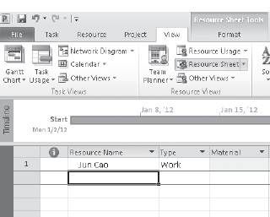
Setting Up Resources - Work Resources
Exercise:
Open Simple Resources_Start project plan located in your exercise.
On the File tab, click Save As.
In the File name box, type Simple Resources, and then click Save.
On the View tab, in the Resource Views group, click Resource Sheet.
Click the cell directly below the Resource Name column heading.
Type Jun Cao, & press Enter.

Slide 70
Setting Up Resources - Work Resources
Exercise:
On the next empty rows in the Resource Name column, enter the following names:
Jun Cao, Sharon Salavaria, Toby Nixon, Toni Poe, Zac Woodall

Slide 71
Setting Up Resources - Entering Resource Capacity
Exercise:
Click the Max. Units field for the Copyeditors resource.
Type or select 400%, and then press Enter.
Click the Max. Units field for Sharon Salavaria, type 50%,

Slide 72
Setting Up Resources - Entering Resource Pay Rates
Exercise: In this exercise, you enter standard and overtime pay rates for work resource.

Slide 73
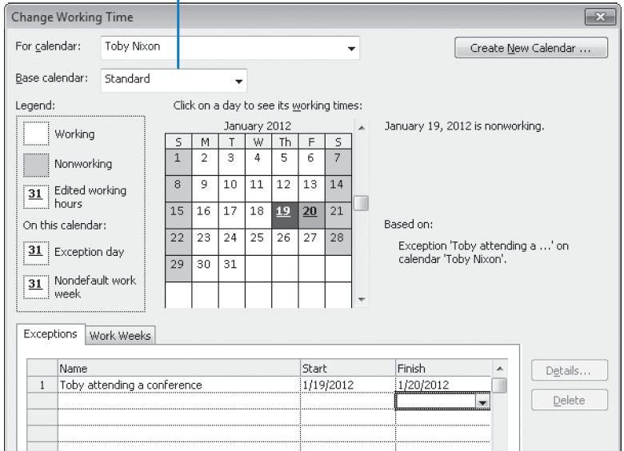
Setting Up Resources - Adjusting Working Time for Individual Resources
Exercise: Toby attending a conference on 19 and 20 Feb

Slide 74
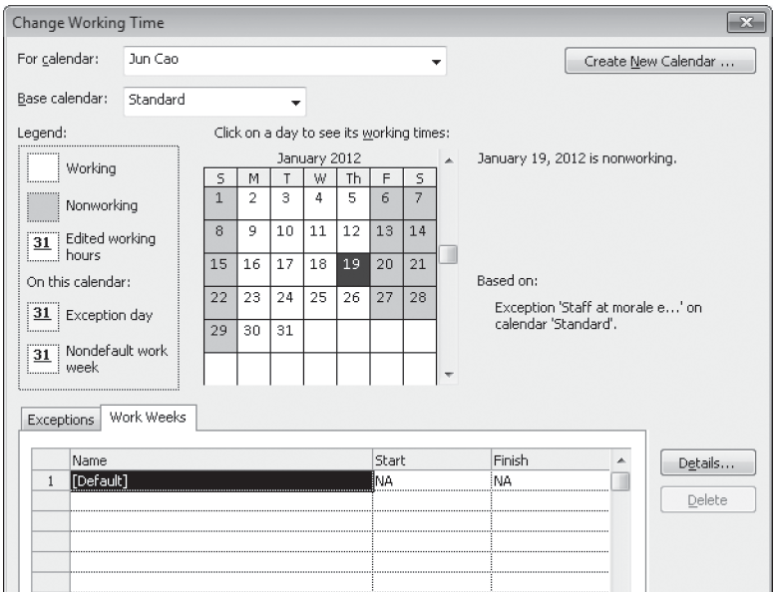
Setting Up Resources - Adjusting Working Time for Individual Resources
Exercise: “4 by 10” work schedule (that is, 4 days per week, 10 hours per day) for a resource Jun Cao.

Slide 75
Setting Up Resources - Setting Up Cost Resources
Common types of cost resources, such as travel, entertainment, or training.
Exercise: Set up a cost resource - Travel

Slide 76
Setting Up Resources - Documenting Resources
Exercise: Enter notes in the Resource Form - Toby Nixon.

Slide 77
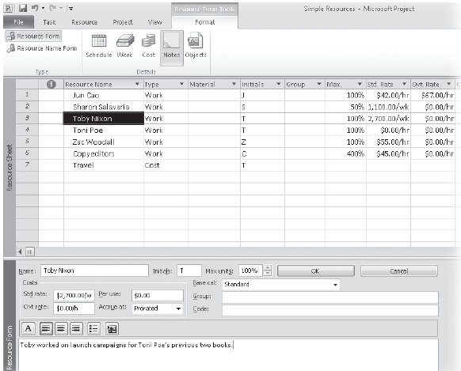
Setting Up Resources - Documenting Resources
Exercise:

Slide 78
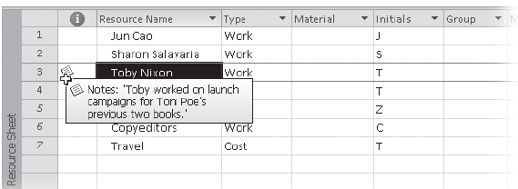
Setting Up Resources - Documenting Resources
Exercise:

Slide 79
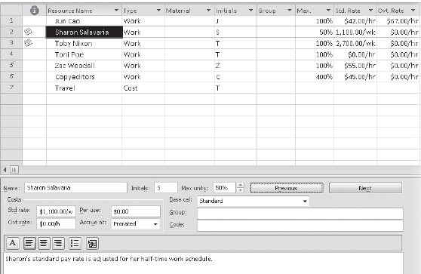
Setting Up Resources - Documenting Resources
Exercise: Type Sharon’s standard pay rate is adjusted for her half-time work schedule

Slide 80
Assigning Resources to Tasks
Assign work resources to tasks.
Control how Project schedules additional resource assignments.
Assign cost resources to tasks.

Slide 81
Assigning Resources to Tasks
Who should be working on what tasks and when?
Do you have the correct number of resources to accomplish the scope of work that your project requires?
Are you expecting a resource to work on a task at a time when that resource will not be available to work (for example, when someone will be on vacation)?
Have you assigned a resource to so many tasks that you have exceeded the capacity of the resource to work—in other words, have you overallocated the resource?

Slide 82
Assigning Resources to Tasks - Assigning Work Resources to Tasks
Exercise:
On the File tab, click Save As.
Project displays the Save As dialog box.
In the File name box, type Simple Assignments, and then click Save.
Before making any resource assignments, you’ll check the project plan’s current duration and cost values for later comparison.
On the Project tab, in the Properties group, click Project Information, and then click Statistics.

Slide 83
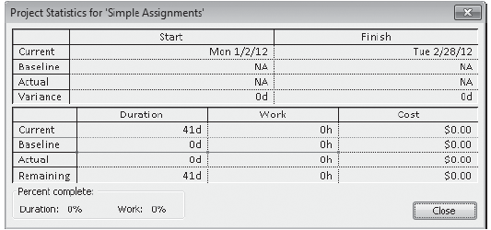
Assigning Resources to Tasks - Assigning Work Resources to Tasks

Slide 84
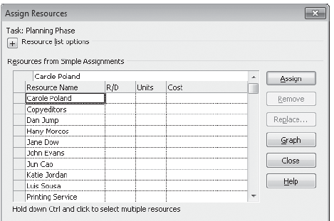
Assigning Resources to Tasks - Assigning Work Resources to Tasks
Exercise: In this exercise, you make some initial resource assignments to tasks.
On the Resource tab, in the Assignments group, click Assign Resources.
Notes:
Need to put in more slides

Slide 85
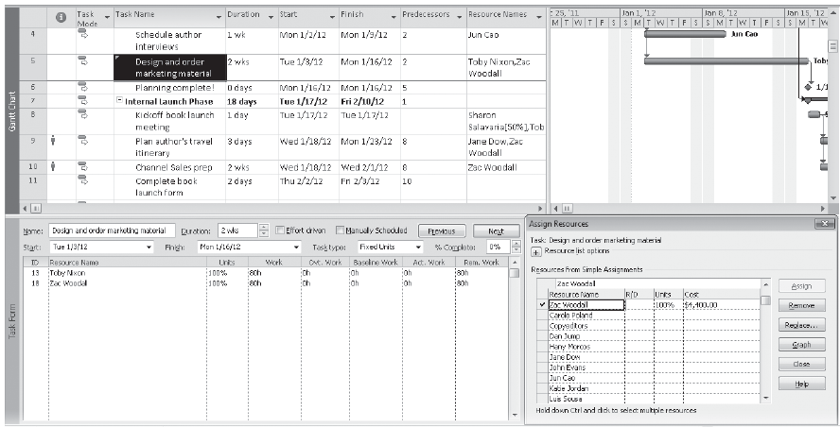
Assigning Resources to Tasks - Controlling Work When Adding or Removing Resource Assignments
Exercise:

Slide 86
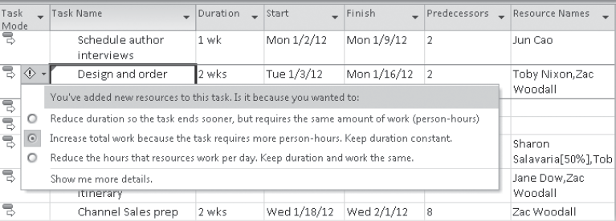
Assigning Resources to Tasks - Controlling Work When Adding or Removing Resource Assignments
Exercise:

Slide 87
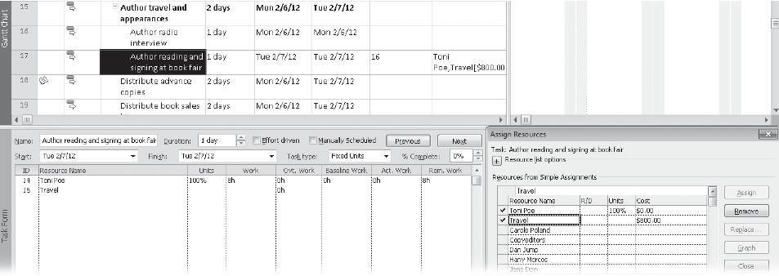
Assigning Resources to Tasks - Assigning Cost Resources to Tasks
Exercise:

Slide 88
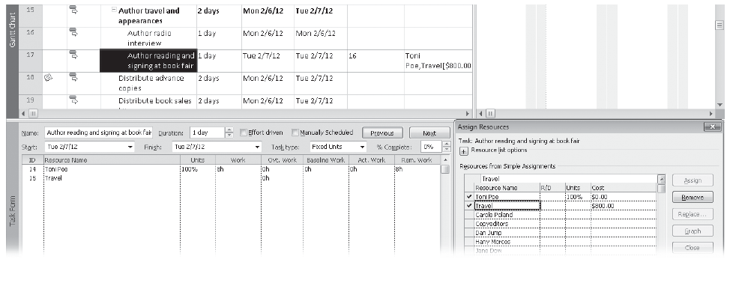
Assigning Resources to Tasks - Assigning Cost Resources to Tasks
Exercise:

Slide 89
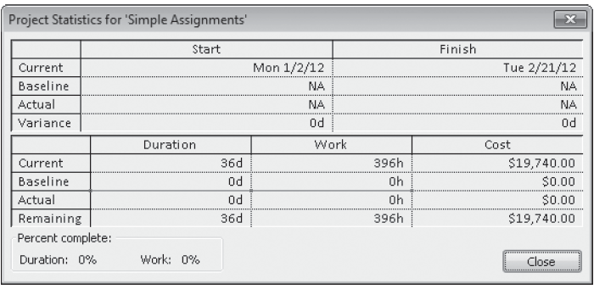
Assigning Resources to Tasks
Check Project Statistics and see impact

Slide 90
Exercise: Renovating the kitchen (WBS / Project plan)
Identify the list items
Identify Summary level and Summary Task
Project Start Day: 11Apr-16
Save Project : Name – Renovating Kitchen
Working Days: 20 Days
off Days – 18 Apr and 19 Apr
Resources: Ali, Asif Khan, Aslam
Asif - Annual Leave 25 to 27 Apr
Every task should have a resource
Avoid resource over allocation
17

Slide 91
WBS - Renovating the kitchen.
18

Slide 92
Formatting and Sharing Your Plan
Customize the Timeline view.
Print views.
Edit and print reports.

Slide 93
Tracking Progress on Tasks
Save current values in a schedule as a baseline.
Record progress on tasks through a specific date.
Record a task’s percentage of completion.
Enter actual work and duration values for tasks.

Slide 94
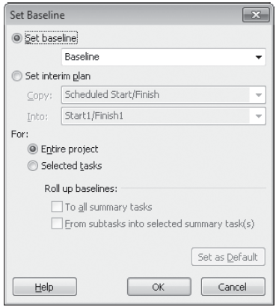
Tracking Progress on Tasks

Slide 95
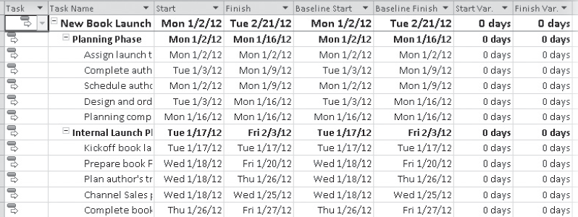
Tracking Progress on Tasks

Slide 96
Thank you!

